Slide 1


Hospital Charges & Patient Care: A Comprehensive Analysis
Optimizing Costs, Enhancing Outcomes through Data Presented by: Ravikanth| Data Analyst | LinkedIn Date: 16-June, 2025

Slide 2
Executive Summary Key Takeaways for Stakeholders
Total Billing Amount: $1417.4M
Average Billing Per Day: $3.4K
Total Insurance Providers: 5
Medications Analyzed: 5
High cost patterns in Obesity, Ibuprofen, and Elective admissions

Slide 3
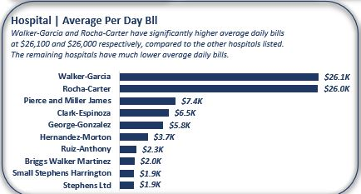
Hospital Billing Breakdown: Daily Charges
Walker-Garcia: $26.1K/day (highest)
Stephens Ltd: $1.9K/day (lowest)
Huge billing variation across 10 hospitals

Slide 4
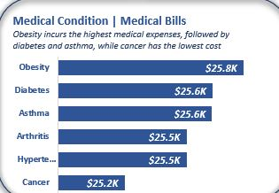
Costliest Conditions to Treat
Obesity: $25.8K
Diabetes/Asthma/Arthritis: $25.5K–25.6K
Cancer: $25.2K (lowest)
Insight: Preventable lifestyle conditions cost the most.

Slide 5
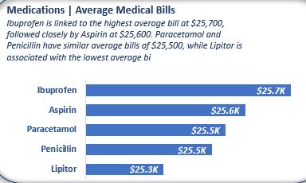
Which Medications Are Most Expensive?
Ibuprofen: $25.7K (highest)
Lipitor: $25.3K (lowest)
Cost not always proportional to treatment severity
Action: Audit prescriptions tied to high billing.

Slide 6
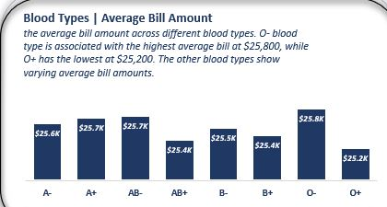
Billing by Blood Type
O- Blood Type patients: $25.8K
O+ Blood Type: $25.2K
Suggests complexity or care variation

Slide 7
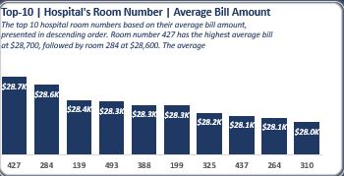
Elective vs Emergency Admission Charges
Elective: $25.6K > Emergency/Urgent: $25.5K
Room 427 costs $28.7K (highest among all)
Action: Review elective billing structure.

Slide 8
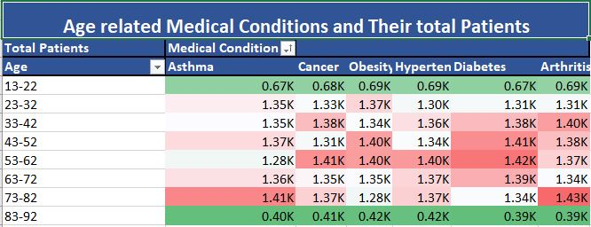
Patient Condition by Age & Month
Ages 43–62 show highest chronic conditions
Monthly volume remains stable year-round
Action: Preventive campaigns for middle-aged demographics

Slide 9
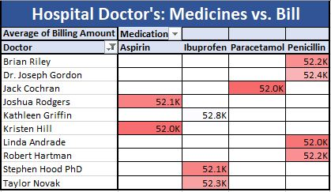
Doctors Linked to High Medication Costs
Joshua Rodgers (Ibuprofen): $52.1K
Kathleen Griffin (Paracetamol): $52.8K
Taylor Novak & Kirsten Hill: Cost-efficient
Action: Build benchmarking model for doctor billing efficiency

Slide 10
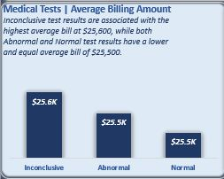
Billing Linked to Test Outcomes
Inconclusive tests → $25.6K (highest)
Normal/Abnormal results → $25.5K
Insight: Diagnostic inefficiencies may inflate costs

Slide 11
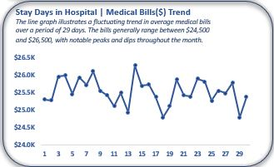
Billing Fluctuation over 29 Days
Billing ranges from $24.0K–$26.5K
Spikes on Days 6, 13, and 21 (likely elective surges)
Action: Forecast peak periods, align resources

Slide 12
Data-Driven Recommendations
Audit high-cost hospitals and doctors
Prioritize chronic disease prevention
Standardize elective billing practices
Monitor drug cost variation
Optimize room usage and test protocols

Slide 13
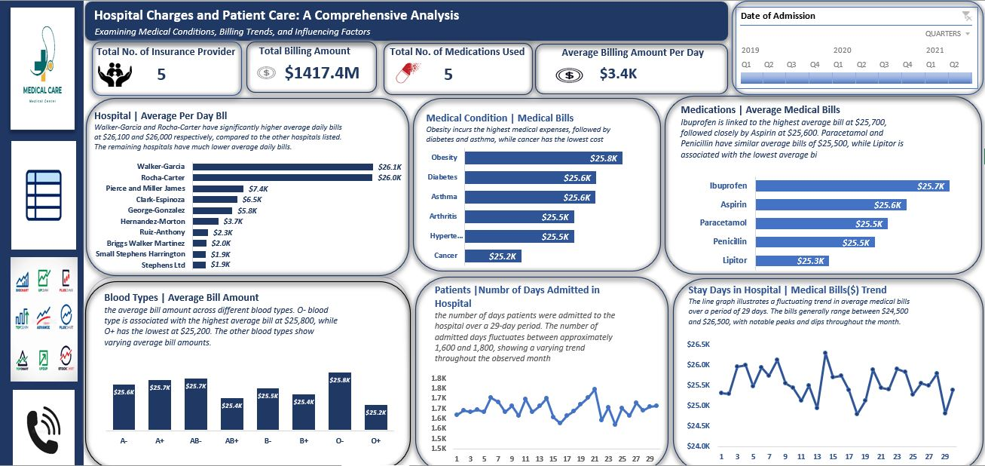

Slide 14
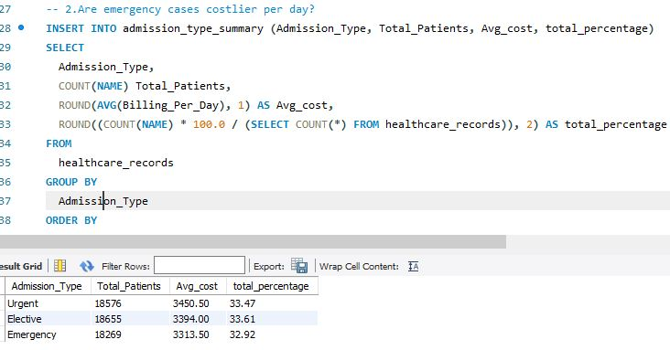
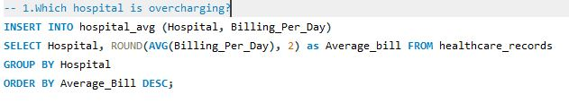
SQL Queries

